Slide 1
Tier 2
The Wilmington Green Box
Notes:
Tori: Hello Everyone! We are the tier two group for the Wilmington Green Box.

Slide 2
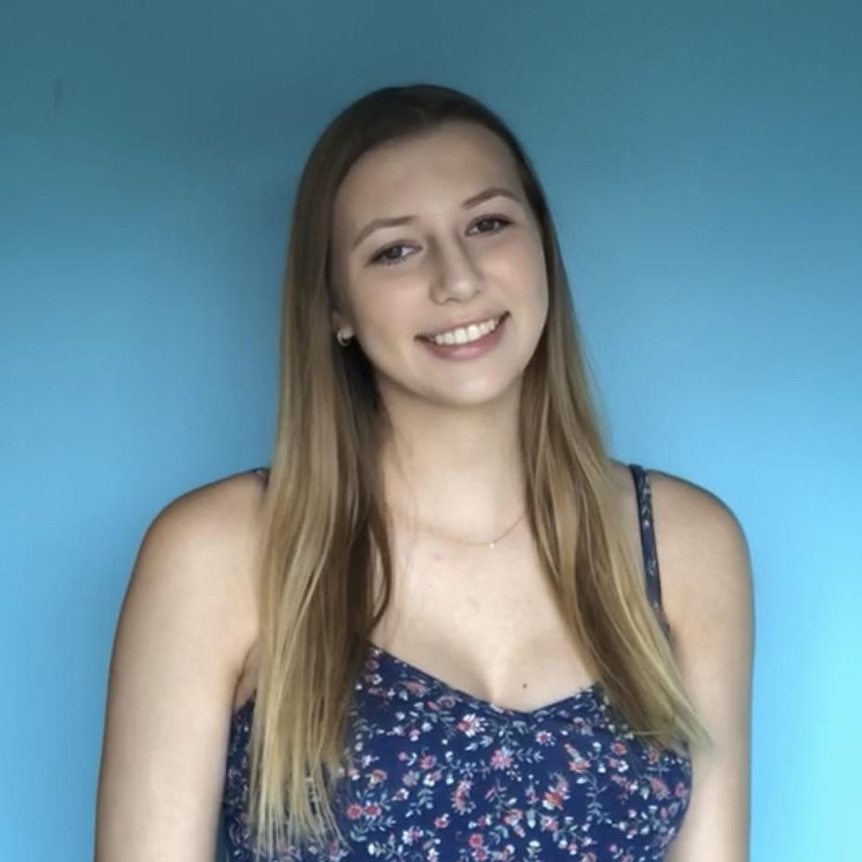
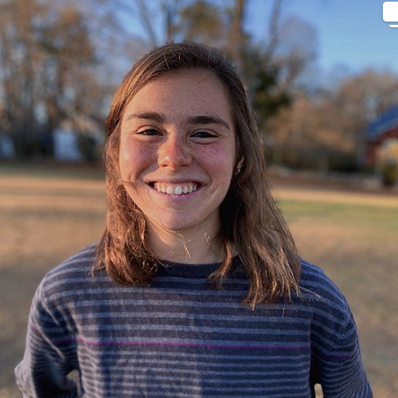
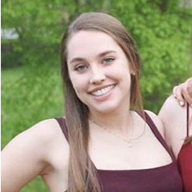
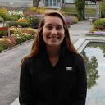
Meet the Team
Tori Reiner
Bailey Davin
Ellie Niesz
Charlotte Breef-Pilz
Sophomore
Biomedical Engineering
Sophomore
Nutrition and Dietetics
Sophomore
Pre-Vet Medicine
Sophomore
Health Behavior Science
Notes:
I am Tori Reiner and I am a sophomore biomedical engineering major.
Hi! I am Bailey Davin and I am…
Hi! I am Ellie Niesz…
Hi! I am Charlotte Breef-Pilz…

Slide 3
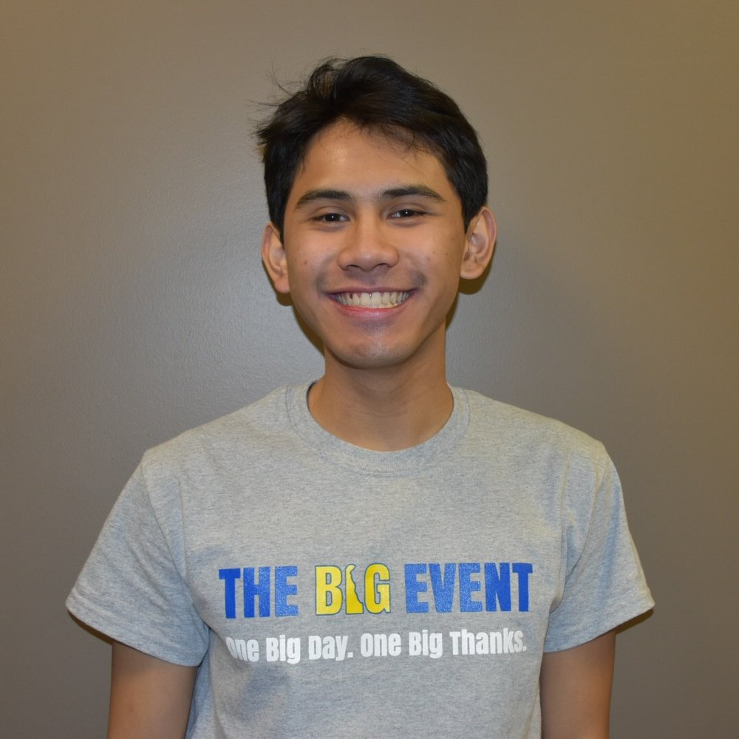
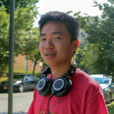
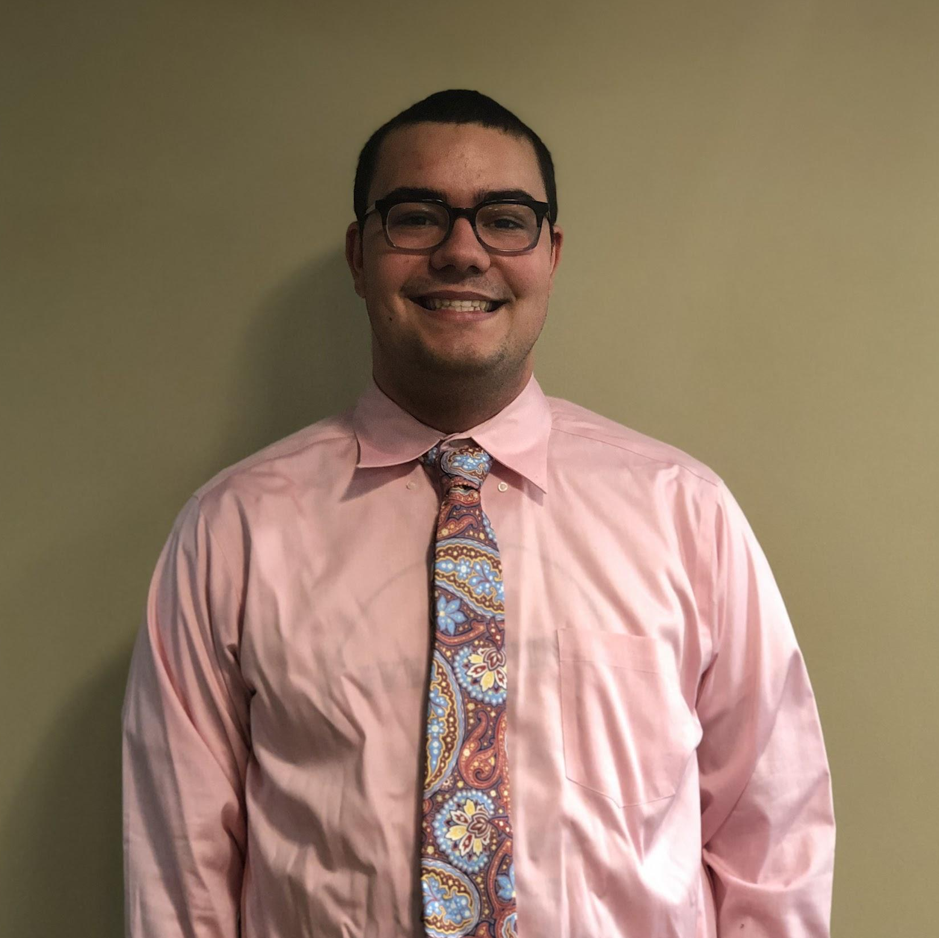
Meet the Team
Joey Lanzona
Daniel Xu
Gabe Wilson
Sophomore
Exercise Science
Sophomore
Chemical Engineering
Sophomore
Communications
Notes:
Hi! I am Joey Lanzona…
Hi! I am Dan Xu…
Hi! I am Gabe Wilson and I am a sophomore communications major.

Slide 4

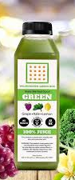
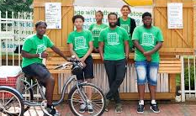
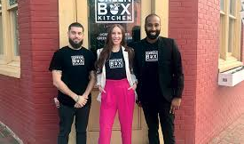
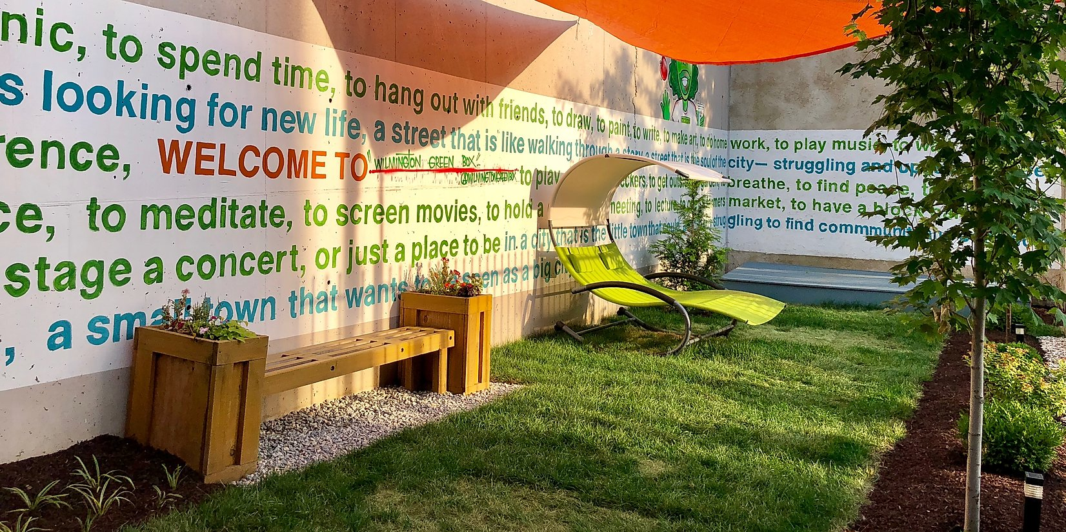
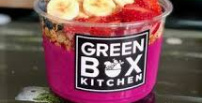
Our Organization Partner
What They Do
The Wilmington Green Box is a nonprofit whose mission is to provide healthy food options and entrepreneurial jobs to at-risk teens.
They have The Green Box Kitchen, a traveling juice cart, an outdoor space with a juice stand, a soon to be urban garden, and much more!
Notes:
JOEY
As introduced, we are partnered with the Wilmington Green Box, a non-profit whose mission is to provide healthy food options and entrepreneurial opportunities to at risk teens.
They do this through their newly opened Green Box Kitchen, the traveling juice cart, open outdoor meeting space with a juice stand, a soon to be urban garden built by us in our project, and much more which all employ teenagers and provide people with healthy food options.

Slide 5
The Timeline
Pivot
2 projects turned into 1
Winter Session
Finished up individual research, finalized plans for the garden, and made a supplies list
COVID-19
Halted our project, have to wait it out
Start of Tier 2
Lots of excitement and bonding with team members
Fall Semester
Focused on research, talking to professionals, and planning
Spring Semester
Ordered supplies, set build dates, and started building
Fall 2020
Hopefully finish building the garden
Notes:
ELLIE AND BAILEY
Bailey: So, as we said, our project was to convert an area of land in Wilmington into an urban garden. At the start of tier two we all began with lots of excitement towards the project and spent time bonding with one another in the team and discussing our whys for being here. This helped to set up a strong sense of becoming a team to reach our common goal of an urban garden.
Ellie: We ended up hitting our first pivot right off the bad. Originally, the Wilmington Green Box group was two separate projects, the urban garden and planning a fundraiser run. The run turned out to be something that we were unable to do, so we were all combined into one large group for the single project of the urban garden. While we were upset about not being able to help with the run, we were all very excited to have the chance to work with each other to build something that we all had a strong attachment to.
Bailey: The entire fall semester was spent planning the garden since it was too early to start building. We focused on research and talking to and getting professional advice. We split into three groups, sustainability, plants, and design. The sustainability group did research and planned how we can make the garden more environmentally friendly. The plants group worked with Jason, our liaison, to figure out what plants he wanted grown and local experts to determine the best ways to grow them. The design group found other urban gardens, did research, and talked to professionals about the overall layout and materials for the garden, and how we would make it look nice. Additionally over the fall semester we took a few trips to Wilmington as a group to see our plot of land and clean it up so we could be prepared for spring.
Ellie: Winter session there wasn’t too much to do since we couldn’t build in the snow and cold, so that time was spent finalizing plans. We all finished up our group research and finalized the overall plans for the garden. A full supplies list was also made with the amounts, prices and places we could find material so we could have everything ordered in the spring.
Bailey: As soon as spring semester started, we got right back to work. Our supplies list was checked by Jason and ordered right away. We picked three dates that worked for most of us to go to Wilmington and build the garden. Of these three dates, we got to the first build date and picked up supplies and started moving wood and things to their spots in the layout.
Ellie: Soon after this first build date is when COVID-19 hit and halted our project. This was very disappointing because we were so close to finishing and getting to see what all of our work lead to. However, we did overcome this by coming up with a plan to finish out our project in the fall. We contacted Jason and updated him on everything and our plans for the future. We are very happy to say that the urban garden will be finished by us in the fall semester.

Slide 6
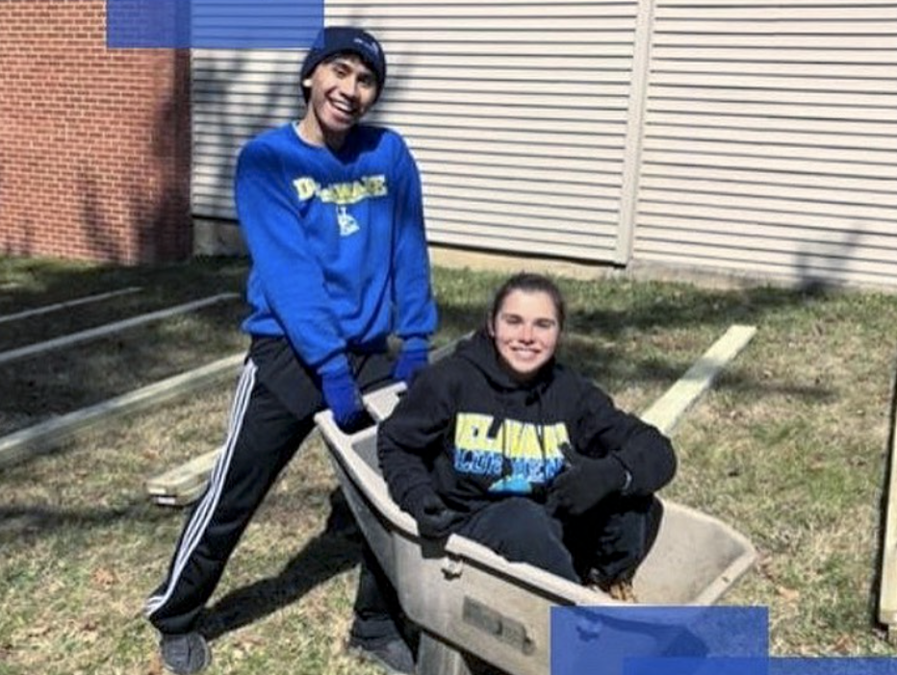
Teamwork
The Good…
People to lean and rely on
A great group of friends
A new found love of community engagement
and the bad.
The importance of compromise
A big team means lots of scheduling difficulties
Notes:
BAILEY AND DAN
Dan: As you saw in our timeline, we have worked through a lot together which has taught us all a ton about teamwork and group leadership. We learned all about the good aspects like having a group of people that you can lean and rely on to get things done. Having others that value similar things like leadership and have the same passion for the project allowed us to flourish throughout the project. It also gave us all a great group of friends and a new found love of community engagement.
Bailey: Of course, with teamwork there always comes a bad side. In particular, in group leadership, we found that everyone being a leader led to some difference of opinions. We all have a different way of looking at things and don’t always agree, but this taught us the importance of compromise. We learned that being right isn’t always the best thing for the team or project and that sometimes another's idea is good as well. Compromising became a good tool for us as we worked through planning the garden with 7 different ideas for how it should look. Also, with 7 different people in our team, we quickly realized scheduling is a huge issue. This problem, along with the tier 2 workshop about different websites to use, showed us the necessity of organization. We worked through this by making sure to take notes at all meetings for anyone who couldn’t go and using websites and other tools to find times that work for all of us. We learned that teamwork takes commitment meaning that if we have to sacrifice an hour of our free time in our hectic lives to meet with the team, we will.

Slide 7
5 Dysfunctions
Lack of Trust: Sharing strengths and shadows before starting the project
Fear of Conflict: Setting team expectations for an open and understanding environment
Lack of Commitment: Created our team charter
Avoidance of Accountability: Listed our individual whys and shared with the team
Inattention to Results: Set individual and common goals to get to the final step, a real garden
Notes:
DAN AND GABE AND CHARLOTTE
Dan: The five dysfunctions of a team are something that every group tends to face, and we are no exception to that. We dealt with each one to overcome them and be a full functioning team to build the best urban garden possible.
Dan: The first dysfunction, lack of trust, was conquered by sharing or strengths and shadows before starting work on the project. Knowing and writing down everyone's strengths allowed us to see how and where each person will work best. We used this knowledge to separate work groups during our research phase and positions for the team charter. Thanks to our large team, we had almost every strength represented. This built trust because we knew each person was capable and eager to do their parts to the best of their ability.
Charlotte: On the other hand, knowing one anothers shadows and how to handle and have tough conversations with people gave us an awesome tool to deal with fear of conflict. We were able to sit down with one another and set good, strong team expectations for an open and understanding environment. Having these said out loud and discussed by the group made sure we all were prepared to work through any possible situations civilly. It turned conflict from arguments of who is right or wrong into an open conversation about why we think each option could be best for the garden with constructive criticism.
Charlotte: Even though this never fully was an issue because we were all eager from the start to the end, we were ready to trump lack of commitment. The team charter that we created and its written down roles committed us to them for the project. Having a document to go back and look at solidified each member to the team and the project for the year.
Gabe: Avoidance of accountability is a little harder to handle, but we did by listing our individual whys and sharing them with the team. Saying out loud why we are here and why we are doing this project brought to light the connections we all individually feel to the project and built individual accountability. We also wrote down these why’s so that if the need every came to revisit the avoidance of accountability, we can remind ourselves and one another of why we are doing this.
Gabe: Finally, inattention to results was an issue anytime we got to focused on a tiny part of the planning and forgot about the bigger picture, a real urban garden. We squashed this by creating individual and common goals to get us to our final destination. Reaching each goal got us to our final design and our opportunity to finally build. Having steps to work through and goals to reach made sure that we were working efficiently to get things done without forgetting about our one last big goal, the built garden.

Slide 8
Dealing with Difficulties
Collaboration
Controversy with Civility
Common Purpose
Challenge: everyone wanted to work on everything
Lack of trust: provide each other with feedback and feel comfortable in our roles
Lack of commitment: designated individual roles
Effect: organized work by individual strengths to get the best out of everyone
Challenge: everyone had a different idea and vision for the urban garden
Fear of conflict: diversity of ideas and open conversation
Effect: honest conversations that brought us to what was best for the garden in the final plan
Challenge: keeping everyone excited and committed to the project, even after COVID-19
Avoidance of accountability: opportunity to manage ourselves
Inattention to results: focused us all on the bigger picture
Effect: a group of amazing people focused on what matters
Notes:
CHARLOTTE AND GABE AND TORI
Tori: Dealing with the 3 C’s can be hard, but we tackled them quick with what we developed in the 5 dysfunctions. Collaboration, as we explained on our teamwork slide, can be hard in a group of leaders, but compromise was the key. Our biggest challenge here was that each one of us wanted to work on every part of the project, but that would just be too hectic. From dealing with lack of trust, we were able to provide each other with feedback and feel comfortable in our roles. Lack of commitment helped us to designate roles, in the team charter, and place people based off of their strengths. The effect was that we had organized work by individual strengths to get the best out of everyone.
Gabe: Controversy with civility came up a lot since everyone had a different idea and vision for the urban garden. Fear of conflict rescued us here because it showed us that the diversity of ideas wasn’t bad and that an open conversation about them could create something even better. We had many honest conversations that led us to what was best for the garden in our final plan.
Charlotte: A common purpose didn’t become a problem until COVID-19 hit and staying excited about the project was difficult without being allowed to do it anymore. This is where avoidance of accountability and inattention to results has played a huge role. We are reminded by them that the reasons we chose this project in the first place still exist despite a pandemic and that even though the timeline may have grown a couple of months, the steps and goals are still there waiting for us until the garden is finished. We are aware that we are an amazing group of people focused on what matters and that this is just a small setback in getting to finish our urban garden that will have a huge impact on the community.

Slide 9
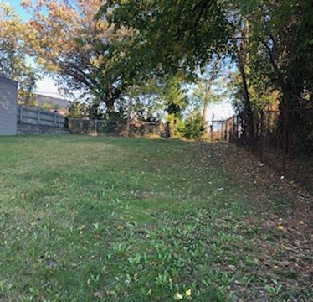
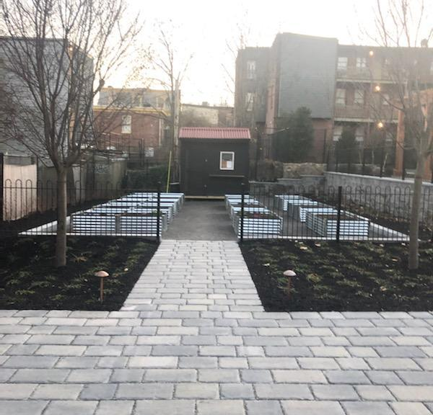
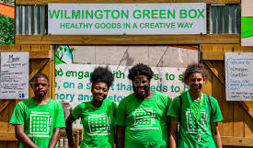
Our Impact
The WGB urban garden will…
Provide at risk teens with a fun and impactful activity
Supply the community with more healthy and organic food options
Reduce the cost of ingredients for the Green Box Kitchen
Organizational assessment of final design:
Clear goals and ranked for importance
A lot of research and use of resources
Analyze each part of the garden design with goals in mind
Share final design with liaison and build it
Notes:
TORI AND JOEY
Tori: While to some people it might just seem like a garden, to us we see all of the people and things that will be positively affected by it. The impact that this garden will have was brought to light for us when Jason brought us on a tour around Wilmington and showed us the areas and the people that will be helped by it. We saw first hand how other projects like this had made lives better and gave us even more reason to give this project our all.
Joey: The Wilmington Green Box Garden will provide at risk teens with a fun and impactful activity to do over the summer while school is out. It will supply the community with more healthy and organic food options no matter if the harden is taken in a community garden route or a selling organic produce route. It will also help the Green Box Kitchen by reducing the cost of ingredients because some of them will be provided from the garden.
Joey: All of those impacts were goals of things we wanted the urban garden to do. So, in the organizational assessment of the final design, these are the goals that we used. The three goals we included were our highest ranked ones. Through a lot of research and use of resources we came up with the best design for the urban garden. Each part was analyzed multiple times without goals in mind to make sure all will be accomplished. To complete the assessment, the final design was shared with Jason for a seal of approval before we got to begin building.

Slide 10

Personal Outcomes
Notes:
*Each talk about our individual personal and professional outcomes of tier 2*
Tori: The impacts that this urban garden will have on the community is huge, but so are the impacts that tier two has had on us personally and professionally. For me, tier 2 has brought me some of my closest friends and even my future roommates. It has taught me a lot about myself, even things I didn’t want to know, and has allowed me to better myself. Professionally, I love learning more and more about leadership because it applies to every part of my life. Many interviews I have been on love hearing me go on about BHLP and everything I have learned. This project in particular, along with the BHLP alt winter break trip I went on, also helped me to realize that I love nature and the environment so much that I want to find a way to incorporate it into my future career.
Ellie:
Charlotte:
Bailey:
Joey: Personally, working with Wilmington Green Box exposed me to a local organization that focused on a mission that I resonated with - exposing accessible vegan food to a wide variety of people while providing career skills and mobility options for at-risk youth of marginalized identities. Although WGB is very much Jason’s project, Tier 2 brought me the opportunity to extend my heart into a project to create an experience that I can call my own. Tier 2 helps support the notion that we should all contribute to something bigger than us and that thing is creating a lasting community impact with tangible and satisfying results. On a professional level, our discussions with Strengths and Shadows in addition to working in a group for the past several months provided me language and ways of expression that helped me secure a position in UD Student Alumni Ambassadors and will hopefully allow me to secure an e-board position.
Dan: I was introduced to nonprofit organizations during last spring break and I was really excited to work with one once I learned that we were going to during Tier 2. Through Tier 2, I was exposed to the Wilmington community and allowed to truly understand and sympathize with WGB's mission. I also learned a lot from the retreat about strengths and shadows which let me embrace what makes me me, and to improve myself in the future. I’ve learned to work cohesively as a team and use our differences to make us stronger. It was really unfortunate that we couldn’t complete the garden this semester, but I can’t wait to finish it once this situation is over.
Gabe:There’s very little I can say that hasn’t already been said by my teammates here. I was able to provide service to a local organization that has a mission that’s deeply meaningful to me. I was able to better not only my leadership skills, but additionally my abilities to step back in a group and let go of the reins. I was able to learn more about what roles I can effectively fill in a team, and the ones where I lack. *include some exit like thank you for listening or we have been honored to work on this project*

